Slide 1
PF-Net: Point Fractal Network for 3D Point Cloud Completion
工学院 钱浩
0121511371020

Slide 2
Information
Title: PF-Net: Point Fractal Network for 3D Point Cloud Completion
Conference: CVPR 2020
Institute: Shanghai Jiao Tong University & SenseTime
Author: Zitian Huang, Yikuan Yu, Jiawen Xu, Feng Ni, Xinyi Le
PDF: https://arxiv.org/pdf/2003.00410.pdf
Code: https://github.com/zztianzz/PF-Net-Point-Fractal-Network.git

Slide 3
Introduction
Why 3D Point Cloud Completion？
occlusion,
light reflection,
transparency of surface material
limitations of sensor resolution and viewing angle
a loss of geometric and semantic information

Slide 4
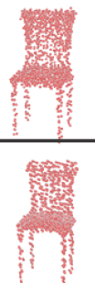
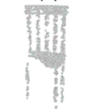
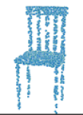
Introduction
input
GT
L-GAN
Previous work：
L-GAN^{[1]}、PCN^{[2]}、RL-GAN-Net^{[3]}
Problems:
learning the general character of a genus/category but not the local details of a specific object
may change the position of known points: genus-wise distortions
PCN
[1] Panos Achlioptas, Olga Diamanti, Ioannis Mitliagkas, and Leonidas J Guibas. Learning representations and generative models for 3D point clouds. ICML, 2018.
[2] Wentao Yuan, Tejas Khot, David Held, Christoph Mertz, and Martial Hebert. PCN: Point completion network. 3DV, 2018.
[3] Muhammad Sarmad, Hyunjoo Lee, and Young Min Kim. RL-GAN-Net: A reinforcement learning agent controlled GAN network for real-time point cloud shape completion. CVPR, 2019.
Notes:
输入：不完整点云，输出：补全后的点云
学习一个类别的特性，而不是某个对象的细节
可能会修改已知点，造成噪声和细节的丢失（椅子背后的横杠）
genus-wise: 类别失真

Slide 5
Introduction
PF-Net：
（1）Only output the missing part
retains the geometric features of the original point cloud
focus on perceiving the location and structure of missing parts
（2）Better feature extraction
Multi-Resolution Encoder(MRE): contain both local & global, low-level & high-level features
（3）Tackle genus-wise distortion：
Point Pyramid Decoder (PPD): predict primary, secondary and detailed points from layers of different depth
Primary points and secondary points: serve as the skeleton center points
3 parts：
Multi-Resolution Encoder (MRE),
Point Pyramid Decoder (PPD)
Discriminator Network
Notes:
主要特点：
输入残缺的点云，输出的残缺的部分，好处：
保留了原始点云的几何特征。
让网络专注于丢失的部分
(2) 更好的特征提取器，包含了…
(3) 解决类别失真：用了点金字塔decoder，提取了一级、二级，更细节的点。一二级的点作为基本点，用于生长出最后的细节的点

Slide 6
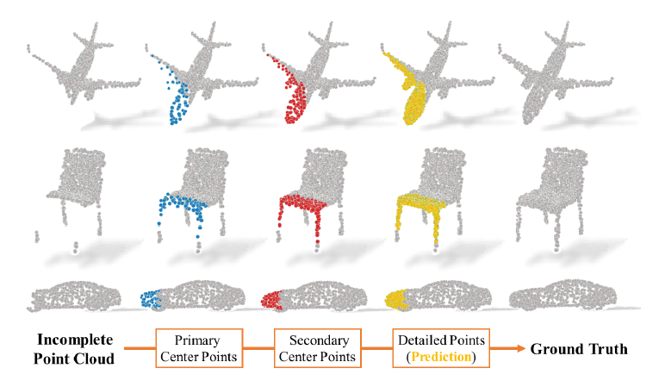
Introduction
Notes:
PPD

Slide 7
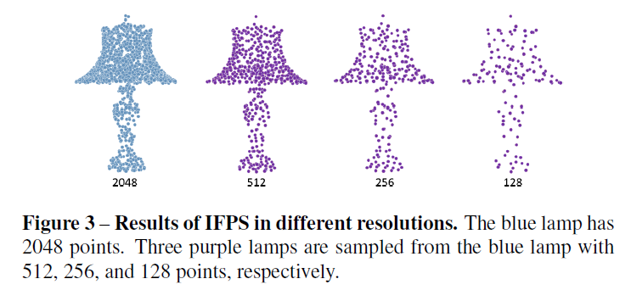
Method
PF-Net：Feature Points Sampling
iterative farthest point sampling (FPS)
（1）A: selected set（n points） B: unselected set（m points）
（2）d_{b}^{i}: the distance between a point in B ( P_{b} ) and i-th point in A ( 0 <= I <=n-1 )
（3）p_{b}^{j} = min([d_{b}⁰, d_{b}¹, … d_{b}^{n-1},])
（4）selected_points = argmax([p_{b}⁰, p_{b}¹, … p_{b}^{m-1},])
Notes:
https://zhuanlan.zhihu.com/p/114522377

Slide 8
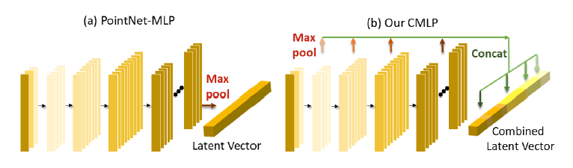
Method
PF-Net：Multi Resolution Encoder
Combined Multi-Layer Perception (CMLP): .
Low-level & high-level features
1024
1920

Slide 9
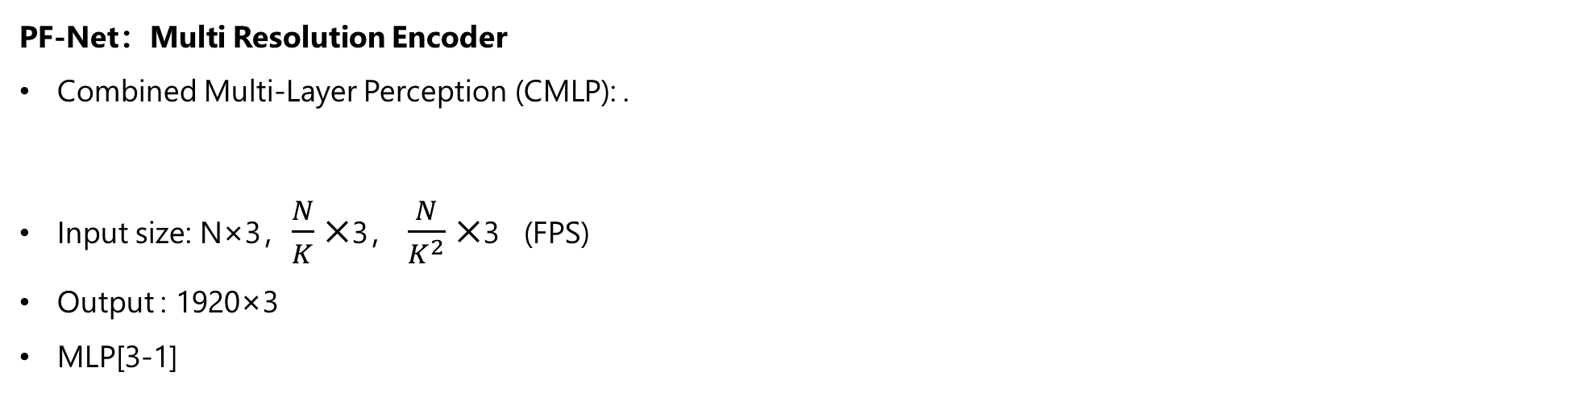
Method
PF-Net：Multi Resolution Encoder
Combined Multi-Layer Perception (CMLP): .
Input size: N×3，$\frac{N}{K}×$3， $\frac{N}{K^{2}}×$3 (FPS)
Output : 1920×3
MLP[3-1]
Local & global features:

Slide 10
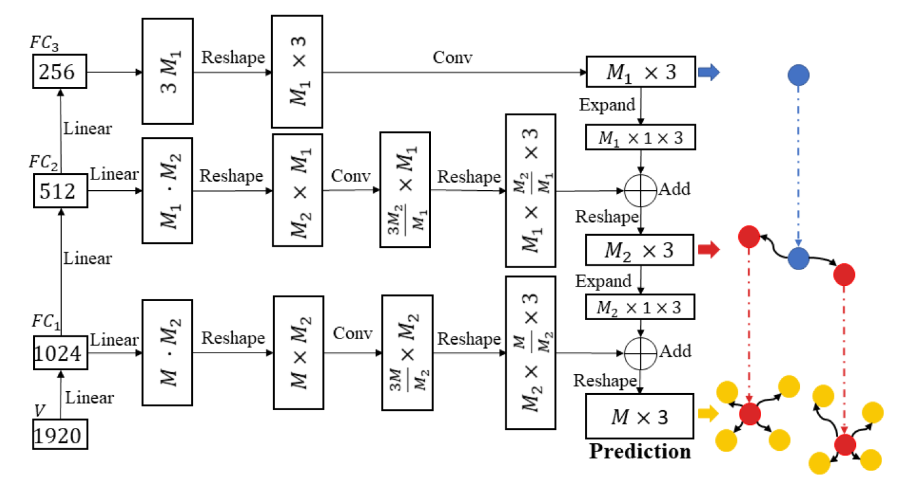
Method
PF-Net：Point Pyramid Decoder
.
primary
secondary
detailed
Notes:
Conv:
Primary：代码里没有conv，只有linear
Secondary：3个conv1d，
self.conv1_1 = torch.nn.Conv1d(512,512,1)
self.conv1_2 = torch.nn.Conv1d(512,256,1)
self.conv1_3 = torch.nn.Conv1d(256,int((self.crop_point_num*3)/128),1)
Detailed：1个conv1d
self.conv2_1 = torch.nn.Conv1d(128,6,1)

Slide 11

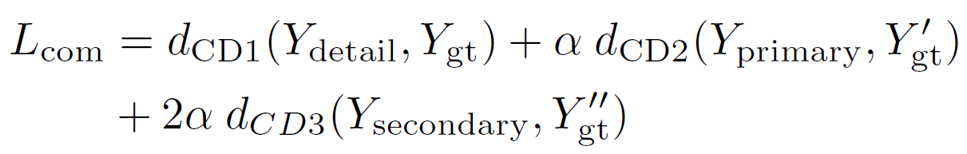
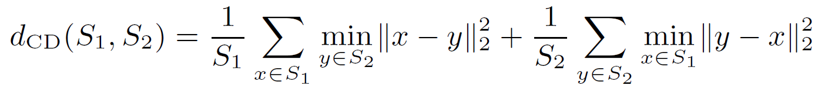
Method
PF-Net：Loss Function
2 parts： multi-stage completion loss & adversarial loss.
.
multi-stage completion loss
Y_{GT}’,Y_{GT}’’: subsampled ground truth. They are the feature points of the missing region
Notes:
分为3个项，分别对应了detail，primary和secondary
用倒角距离。CD in measures the average nearest squared distance between predicted point cloud
注意这边的gt都是残缺的，降采样得到的gt点就是gt骨骼的点，也是网络要学习的点

Slide 12
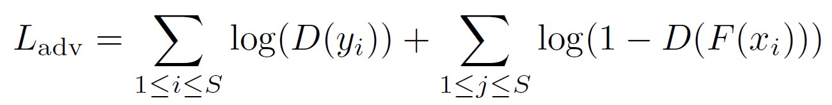



Method
PF-Net：Adversarial Loss
MRE ： Multi-Resolution Encoder
PPD ： Point Pyramid Decoder
predicted missing region
Discriminator：a classification network with similar structure as CMLP
MLP [64-64-128-256] -> Latent vector F : 448（64+128+256）
FC[256,128,16,1]
sigmoid
Notes:
MLP: conv2d
FC：linear

Slide 13
Experiments
Evaluation index
Pred → GT error：
the average squared distance from each point in prediction to its closest in ground truth
measure how difference the prediction is from the ground truth
GT → Pred error：
the average square distance from each point in the ground truth to its closest in prediction
Indicate the degree of the ground truth surface being covered by the shape of the prediction

Slide 14
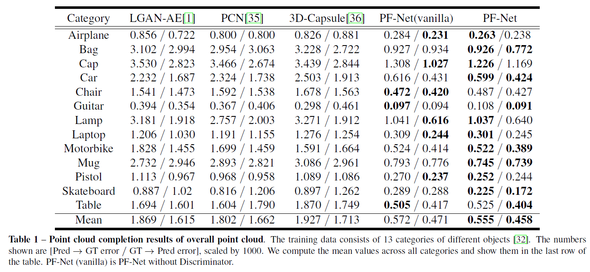
Experiments
Overall point cloud
Notes:
Vanilla：没有discriminator
可见D可以让生成的点云更加真实

Slide 15
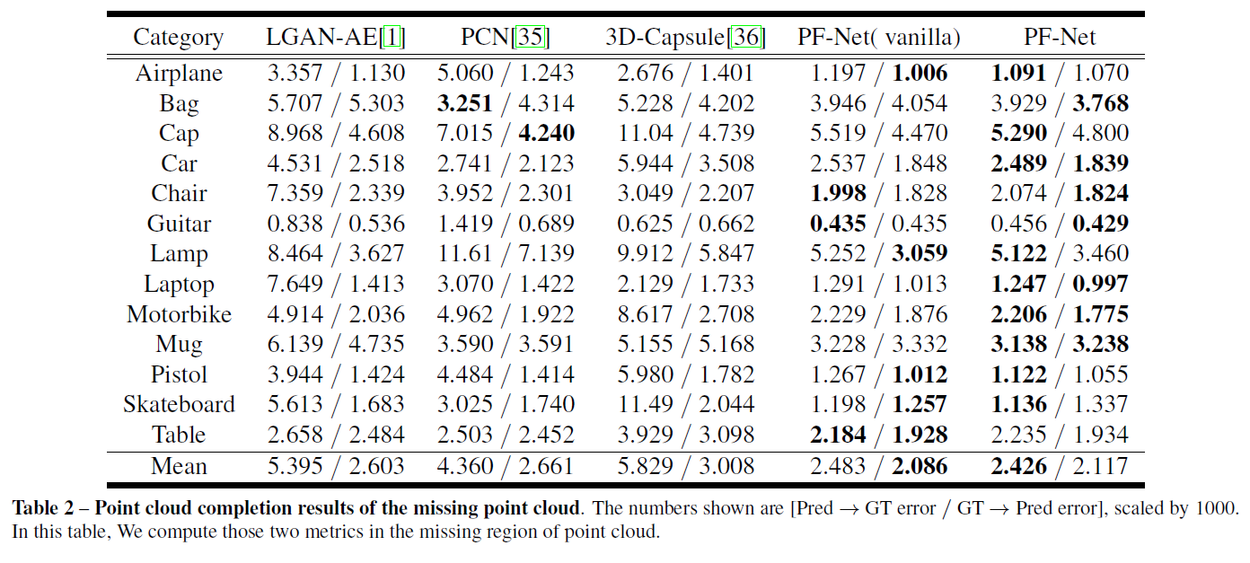
Experiments
Missing point cloud

Slide 16
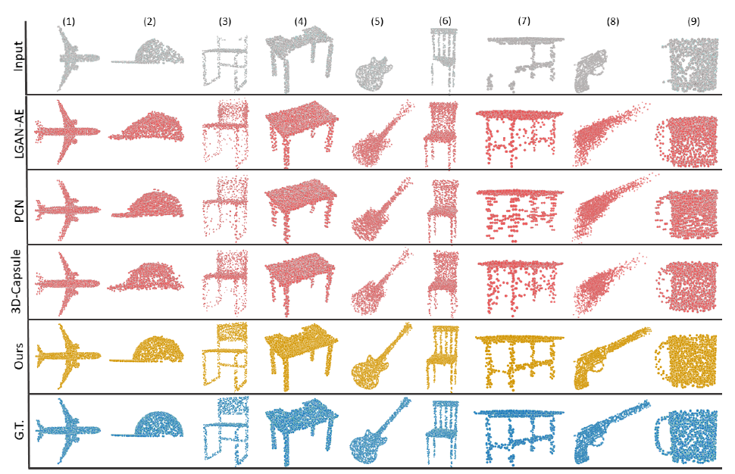
Experiments

Slide 17
THANK YOU FOR WATCHING
钱浩
0121511371020

